Slide 1

By Kent Feng, Jasmeet Narang, and Andrey Shtukenberg

Slide 2

About shared_studios
An art project turned into a company
Connect people all over the world via Portals
Portal - a space equipped with immersive audiovisual technology
Allows to completely see the person on the other end

Slide 3
Portal Design
Projector
Enter Here

Slide 4
First Portal
Built: 2014
Connected: Tehran, Iran and Lower East Side of New York, America
One Conversation Length: 8 minutes
First Permanent Portal
Built: March 2015
Connected: Herat, Afghanistan and world

Slide 5
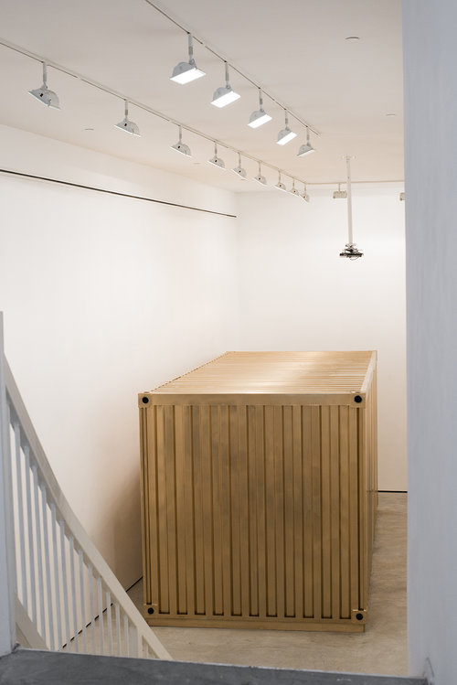
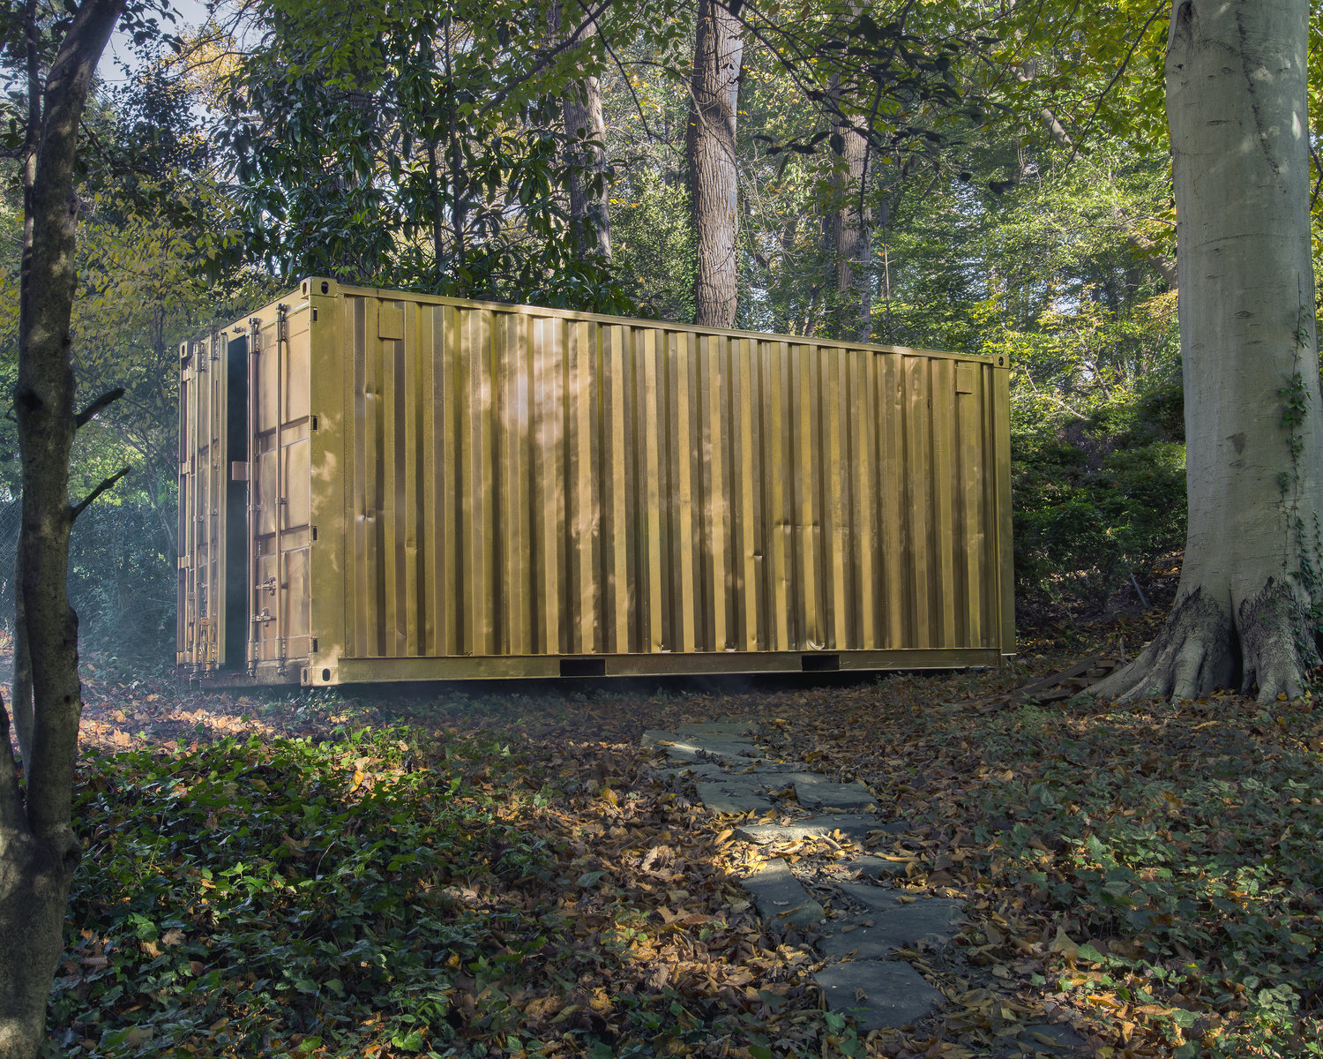
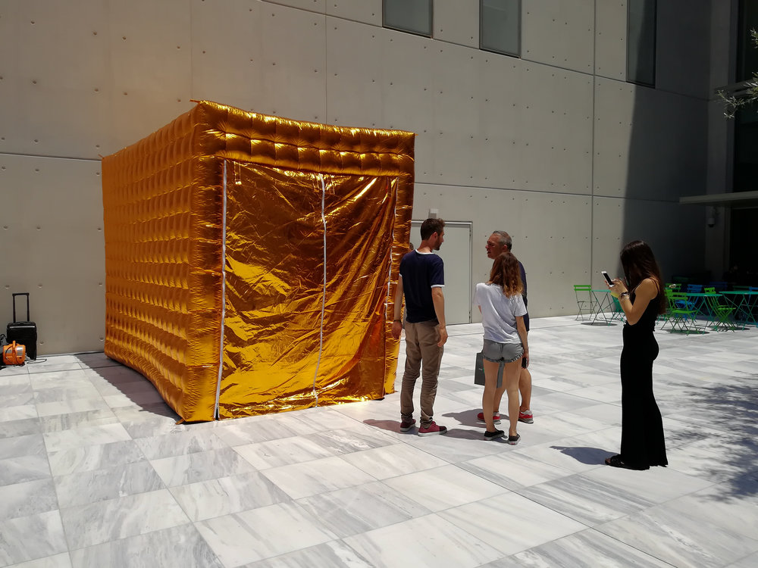
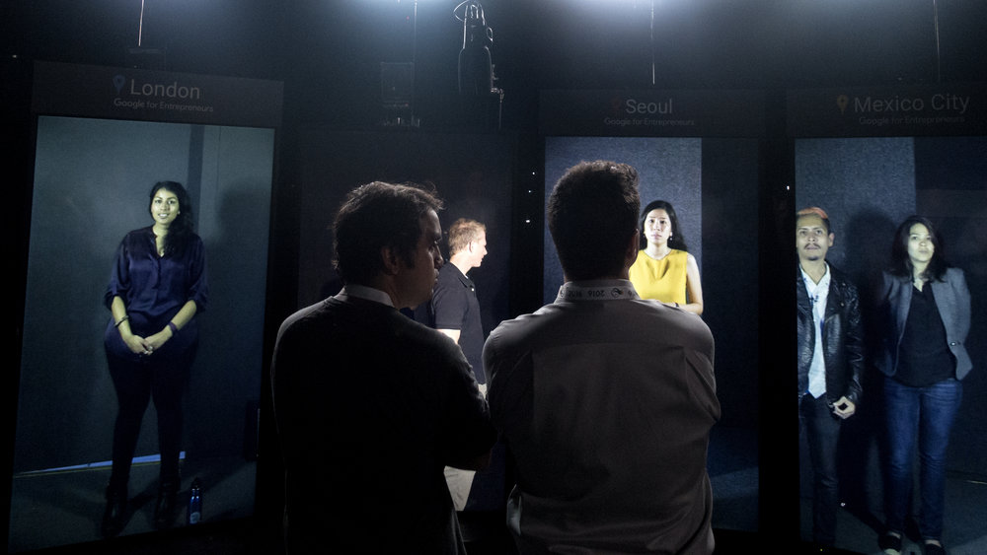
Indoor Portal
Outdoor Portal
Inflatable Portal
Portal Screen

Slide 6
About Portals
Since 2014, over 50,000 have visited Portals and had 20 minute conversations with strangers from the other side of the globe
There are over 22 Portals in the world with 15 more coming soon.

Slide 7

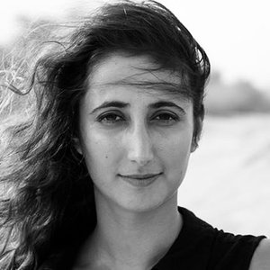
Founders
Founder & Creative Director - Amar C. Bakshi
Amar C. Bakshi is an artist whose work focuses on how to integrate technology into environments and across pronounced distance to create new forms of digital-physical public spaces that challenge and subvert existing norms
Co-Founder and Director of Global Development - Michelle Moghtader
Michelle Moghtader runs global development for Shared_Studios.

Slide 8
Story Behind Portals
“I wondered: What if you could enter a door at the back of your local coffee shop in the morning, and see live into Lahore, Pakistan? What if you could share your morning coffee with people sipping their evening tea across the world, as if in the same room?” - Amar C. Bakshi
Just a couple weeks after the NYC-Tehran Portal closed, we got an email from Herat, Afghanistan. A computer science professor, Omid Habibi, had heard about Portals on BBC Persian and wanted one at his university in Herat, Afghanistan.

Slide 9
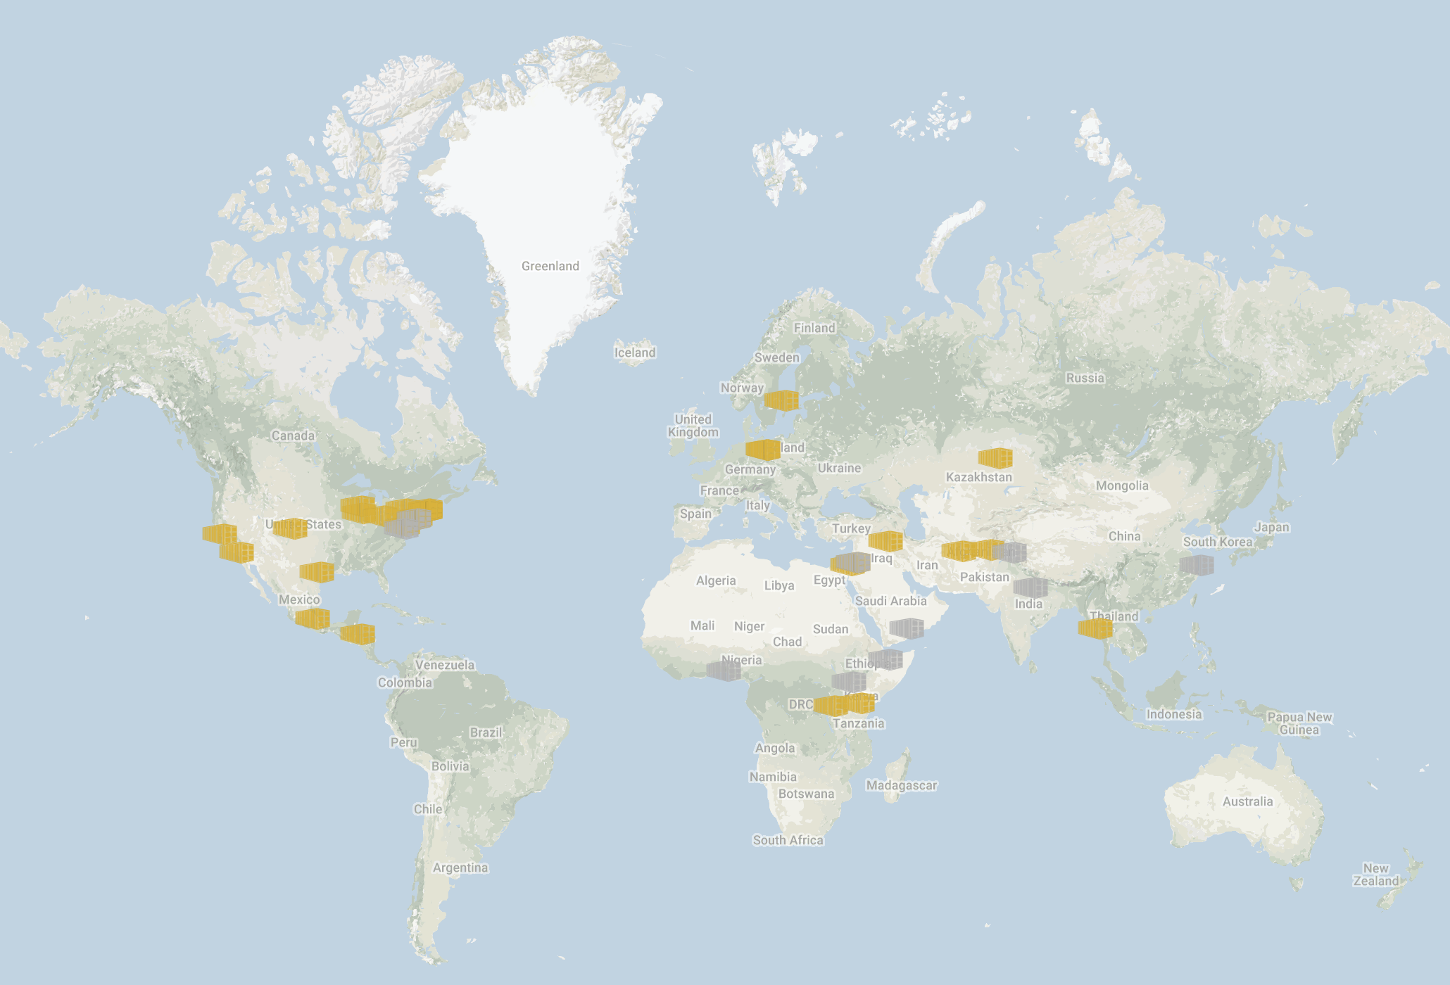
Portal Locations
Myanmar
Palestine
Rwanda
South Korea
Spain
United Kingdom
Kenya
United States
Mexico
Afghanistan
Cuba
Jordan
Germany
Honduras
India
Iraq
Iran
Kazakhstan

Slide 10
Business Model
Gain interest of the public by placing portals in various places around the world.
Flow
Find a sponsor/partner to fund the portal and the operational costs.
Chooses the locations to place portals
Design/Promote/Educate local people about the portal
Connect sponsors/partners to the portal to cover costs.
Deploy portal
Maintain portal by working with sponsor, continuing to promote said portal, gather feedback to improve portals.

Slide 11
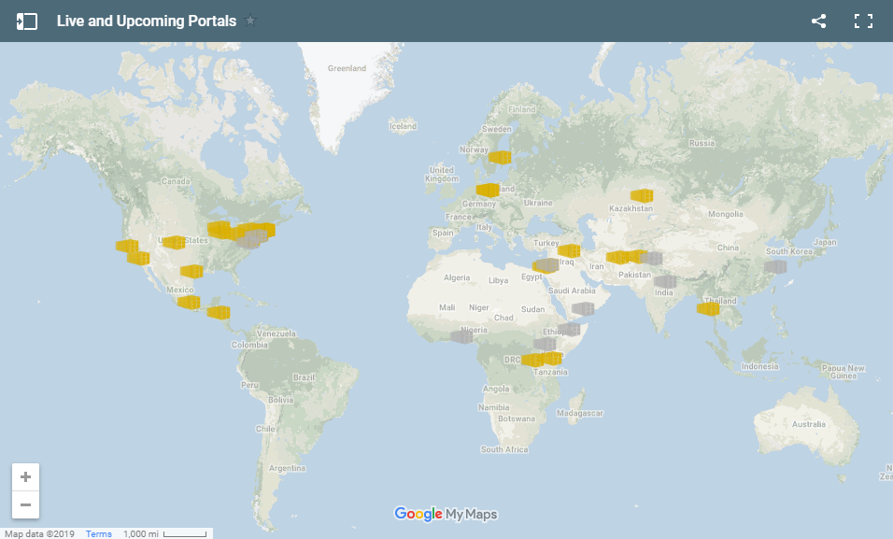
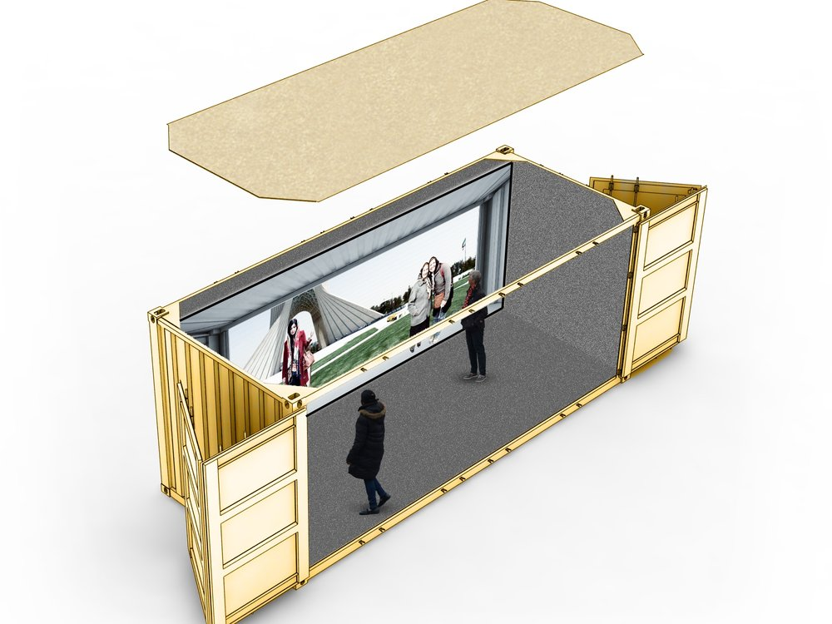

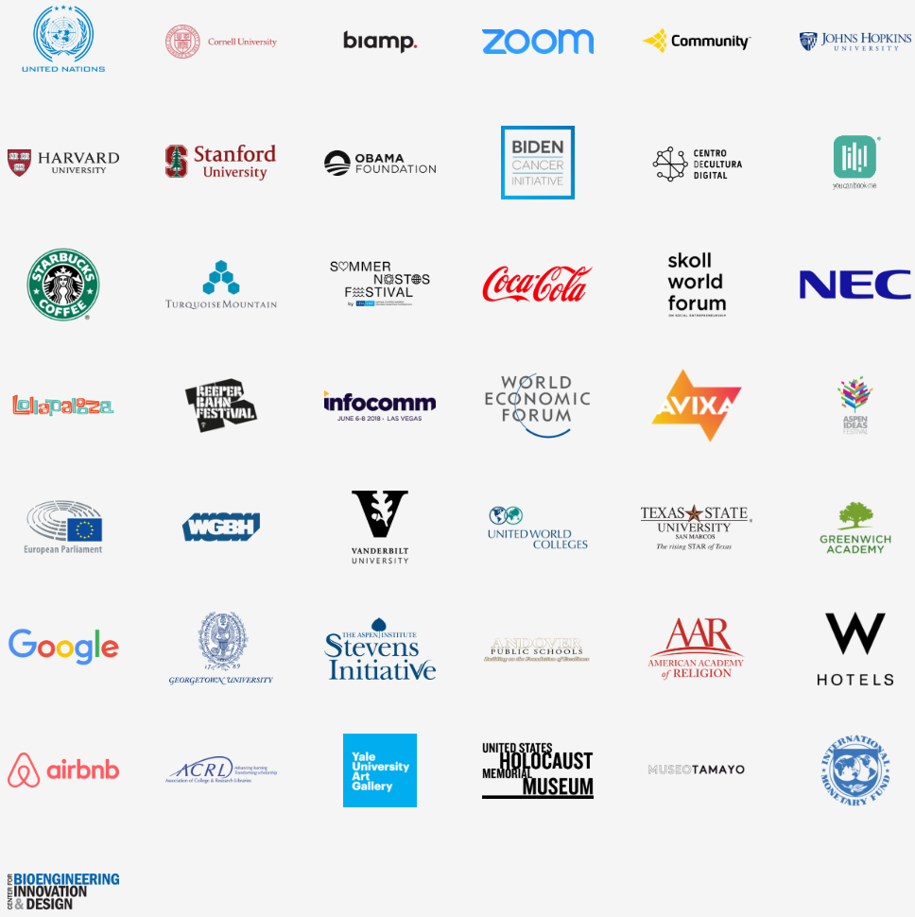

Business Model Diagram

Slide 12
Reception
Received a wide media coverage:
CNN - The Portals Project: This gold box is ‘better than Facebook’
ABC - Portals Humanizing Conflicts Around the World
Quartz: The UN is using virtual reality and an immersive “wormhole” to connect diplomats with Syrian refugees quart
A Great Divide: Bronx Students Engage in Cultural Exchange with Kentucky Students

Slide 13
Thank you!
Source:
https://www.sharedstudios.com/

